Slide 1
Tarlatamab for patients with previously treated small cell lung cancer (SCLC): Primary analysis of the phase 2 DeLLphi-301 study
Luis Paz-Ares¹, Myung-Ju Ahn², Enriqueta Felip³, Sabin Handzhiev⁴, Ippokratis Korantzis⁵, Hiroki Izumi⁶, Kadoaki Ohashi⁷, Margarita Majem⁸, Jürgen Wolf⁹, Martin Reck¹⁰, Horst-Dieter Hummel¹¹, Fiona Blackhall¹², Anne-Marie C. Dingemans¹³, Taofeek K. Owonikoko¹⁴, Suresh S Ramalingam¹⁵, Jacob Sands¹⁶, Tony Jiang¹⁷, Sujoy Mukherjee¹⁷, Erik S. Anderson¹⁷, Byoung Chul Cho¹⁸
¹Hospital Universitario 12 de Octubre, Universidad Complutense, CNIO-H12o Lung Cancer Unit and Ciberonc, Madrid, Spain; ²Samsung Medical Center, Sungkyunkwan University School of Medicine, Seoul, Republic of Korea; ³Lung Cancer Unit, Oncology Department, Vall d’Hebron University Hospital, Barcelona, Spain; ⁴Klinische Abteilung für Pneumologie, Universitätsklinikum Krems, Krems, Austria; ⁵Department of Medical Oncology, Saint Loukas Hospital, Thessaloniki, Greece; ⁶Department of Thoracic Oncology, National Cancer Center Hospital East, Kashiwa, Japan; ⁷Department of Respiratory Medicine, Okayama University Hospital, Okayama, Japan; ⁸Hospital de la Santa Creu i Sant Pau, Barcelona, Spain; ⁹Department I Internal Medicine - Center for Integrated Oncology, Universitätsklinikum Köln (AöR), Cologne, Germany; ¹⁰Lungen Clinic, Airway Research Center North, German Center for Lung Research, Grosshansdorf, Germany; ¹¹Translational Oncology/Early Clinical Trial Unit, Universitätsklinikum Würzburg, Comprehensive Cancer Center Mainfranken, Würzburg, Germany; ¹²The Christie NHS Foundation Trust, Manchester, UK; ¹³Department of Pulmonary Medicine, Erasmus MC Cancer Institute, Rotterdam, Netherlands; ¹⁴Division of Hematology-Oncology, UPMC Hillman Cancer Center, Pittsburgh, PA, USA; ¹⁵Winship Cancer Institute of Emory University, Atlanta, GA, USA; ¹⁶Dana-Farber Cancer Institute, Harvard Medical School, Boston, MA, USA; ¹⁷Amgen Inc., Thousand Oaks, CA, USA; ¹⁸Yonsei Cancer Centre, Yonsei University College of Medicine, Seoul, South Korea.
SC-AT-AMG 757-00039 1023
Presented at the European Society for Medical Oncology Congress 2023 Annual Meeting, October 20-24, 2023; Madrid, Spain.

Slide 2
Diese Präsentation ist urheberechtlich geschützt durch Amgen GmbH. Amgen GmbH stellt dieses Präsentationsmaterial für Angehörige des medizinischen Fachkreises mit Zugang zur Oncology Horizons Webseite zur Verfügung. Es dient ausschließlich zur eigenen Verwendung und darf nicht an Dritte weitergeleitet werden. Es dürfen keine inhaltlichen Änderungen vorgenommen werden.
SC-AT-NP-00098 10.23

Slide 3
Declaration of Interests
Dr. Luis Paz-Ares reports:
Leadership: ALTUM Sequencing, Genomica
Honoraria: Amgen, AstraZeneca, Bayer, BeiGene, Bristol Myers Squibb, Daiichi Sankyo, GlaxoSmithKline, Janssen, Lilly, Medscape, Merck Serono, Mirati Therapeutics, MSD, Novartis, Pfizer, PharmaMar, Regeneron, Roche/Genentech, Sanofi, Takeda
Speakers’ Bureau: AstraZeneca, BMS, Lilly, Merck Serono, MSD Oncology, Pfizer, Roche/Genentech
Research Funding: AstraZeneca (Inst), BMS (Inst), Kura Oncology (Inst), MSD (Inst), Pfizer (Inst), PharmaMar (Inst)
Other Relationship: Amgen, Ipsen, Merck, Novartis, Pfizer, Roche, Sanofi, SERVIER
Presented at the European Society for Medical Oncology Congress 2023 Annual Meeting, October 20-24, 2023; Madrid, Spain.

Slide 4
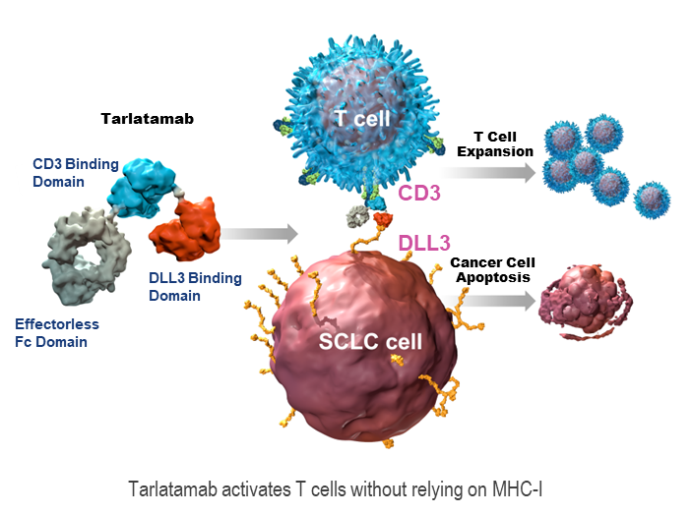
Background
Small cell lung cancer (SCLC) is an aggressive disease with poor survival outcomes and no approved therapies in the third-line and beyond^{1–3}
Tarlatamab is a BiTE® (bispecific T-cell engager) immunotherapy that binds to both delta-like ligand 3 (DLL3) on SCLC cells and CD3 on T cells, leading to T cell-mediated cancer cell lysis⁴
Tarlatamab showed manageable safety and promising antitumor activity in a phase 1 study in previously treated SCLC⁵
Tarlatamab activates T cells without relying on MHC-I
Here, we present the phase 2 DeLLphi-301 study of tarlatamab in patients with advanced SCLC previously treated with 2 or more lines of therapy
CD3, cluster of differentiation 3; Fc, fragment crystallizable; MHC-I, major histocompatibility complex-I.
Presented at the European Society for Medical Oncology Congress 2023 Annual Meeting, October 20-24, 2023; Madrid, Spain.

Slide 5
DeLLphi-301 Study Design
Phase 2, open-label study (NCT05060016)
Part 1:
Dose Evaluation
Part 2:
Dose Expansion
Part 3:
Reduced Inpatient Monitoring Period
Tarlatamab 10 mg
(n = 88)
1 mg on Day 1, followed by 10 mg
on Days 8, 15, and Q2W thereafter
Key Inclusion Criteria
ES-SCLC
Previous treatment with ≥ 2 lines (including platinum-doublet)
ECOG PS 0–1
Measurable disease
Treated and stable brain metastases allowed
Tarlatamab 10 mg
(n = 12)
Same dosing as in Part 1
Tarlatamab 10 mg
(n = 34)
Same dosing as in Part 1
R
1:1
Dose Selection*
Tarlatamab 100 mg
(n = 88)
1 mg on Day 1, followed by 100 mg
on Days 8, 15, and Q2W thereafter
ITT analysis set
Primary Endpoint: ORR per RECIST v1.1 by BICR, TEAEs, tarlatamab serum concentrations
Secondary Endpoints Included: DOR, DCR, PFS per RECIST v1.1 by BICR, OS
*Once 30 patients per dose level had the opportunity to confirm an objective response after the first post-treatment scan or ≥ 13 weeks of follow-up, whichever occurred first.
BICR, blinded independent central review; DCR, disease control rate; DOR, duration of response; ECOG PS, Eastern Cooperative Oncology Group performance status; ES-SCLC, extensive stage-small cell lung cancer; ITT, intention-to-treat; ORR, objective response rate; OS, overall survival; PFS, progression-free survival; Q2W, every 2 weeks; R, randomization; RECIST, Response Evaluation Criteria in Solid Tumors; TEAE, treatment-emergent adverse event.
Presented at the European Society for Medical Oncology Congress 2023 Annual Meeting, October 20-24, 2023; Madrid, Spain.

Slide 6
Baseline Characteristics
 | Part 1 + 2 Tarlatamab 10 mg (n = 100) | Part 1 Tarlatamab 100 mg (n = 88) | Part 3 Tarlatamab 10 mg (n = 34)
Median age, years (range) | 64 (35–82) | 62 (34–80) | 66 (49–80)
Male, % | 72 | 70 | 71
Asian / Black or African American / White,* % | 41 / 0 / 58 | 41 / 0 / 58 | 6 / 3 / 91
Ever smoker / non-smoker, % | 92 / 8 | 94 / 6 | 97 / 3
ECOG performance status: 0 / 1, % | 26 / 74 | 27 / 73 | 29 / 71
Prior lines of therapy, median (range) | 2 (1–6) | 2 (1–8) | 2 (2–6)
2 prior lines of therapy, % | 65 | 55 | 65
≥ 3 prior lines of therapy, % | 33 | 43 | 35
Prior anti-PD-(L)1 treatment, % | 73 | 70 | 82
< 90 days to progression after first-line platinum therapy,† % | 28 | 20 | 21
Brain / liver metastases, % | 23 / 39 | 36 / 34 | 12 / 35
DLL3 expression (> 0%), n/N evaluable (%) | 80/83 (96) | 71/74 (96) | N/A‡
Data cutoff, June 27, 2023. Median follow-up was 10.6 months for tarlatamab 10 mg and 10.3 months for tarlatamab 100 mg.
*No patients of American Indian, Alaska Native, Native Hawaiian, or other Pacific Islander race were enrolled.
†Platinum sensitivity was calculated as end of first-line platinum therapy to date of first progression.
‡DLL3 sample analysis from Part 3 in progress.
DLL3, delta-like ligand 3; ECOG, Eastern Cooperative Oncology Group; N/A, not available; PD-(L)1, programmed death 1 / ligand 1.
Presented at the European Society for Medical Oncology Congress 2023 Annual Meeting, October 20-24, 2023; Madrid, Spain.

Slide 7
Tarlatamab Anti-tumor Activity
Outcome | Tarlatamab 10 mg (n = 100) | Tarlatamab 100 mg (n = 88)
Objective response rate, n (%) (97.5% CI) | 40 (40) (29, 52) | 28 (32) (21, 44)
Complete response | 1 (1) | 7 (8)
Partial response | 39 (39) | 21 (24)
Stable disease | 30 (30) | 27 (31)
Progressive disease | 20 (20) | 13 (15)
Not evaluable / no post-baseline scan* | 10 (10) | 20 (23)
Observed duration of response ≥ 6 months, n/N (%) | 23/40 (58) | 17/28 (61)
Disease control rate, n (%) (95% CI) | 70 (70) (60, 79) | 55 (63) (52, 73)
Tarlatamab 10 mg demonstrated anti-tumor activity in heavily pre-treated SCLC with an objective response rate of 40%
Data cutoff, June 27, 2023. Median follow-up was 10.6 months for tarlatamab 10 mg and 10.3 months for tarlatamab 100 mg. The efficacy analysis set consists of patients in Parts 1 and 2 (N = 188). Part 3 did not have adequate follow-up for response analysis.
*Not evaluable and no post-baseline scan were considered non-responders for response analysis.
SCLC, small cell lung cancer.
Presented at the European Society for Medical Oncology Congress 2023 Annual Meeting, October 20-24, 2023; Madrid, Spain.

Slide 8
Anti-tumor Activity
140
Tarlatamab 10 mg
(n = 91)
Tarlatamab 100 mg
(n = 70)
120
100
Response
DLL3 Expression†
*
Not evaluable / unavailable
80
CR
SD
*
PR
PD
Undetectable DLL3
60
NE
All other patients shown
had detectable DLL3
40
*
*
Best % Change From Baseline in Sum of Diameters
20
*
*
0
*
*
*
*
–20
*
*
–40
*
*
*
*
–60
*
*
*
*
*
*
*
*
–80
–100
*
*
Responses were observed regardless of DLL3 expression, as well as in patients without evaluable tumor tissue
Shown are 91 of 100 patients (tarlatamab 10 mg) and 70 of 88 patients (tarlatamab 100 mg) who had available post-baseline measurements of target lesions.
†DLL3 expression was assessed by immunohistochemistry of tumor tissue samples.
CR, complete response; DLL3, delta-like ligand 3; NE, not evaluable; PD, progressive disease, PR, partial response; SD, stable disease.
Presented at the European Society for Medical Oncology Congress 2023 Annual Meeting, October 20-24, 2023; Madrid, Spain.

Slide 9
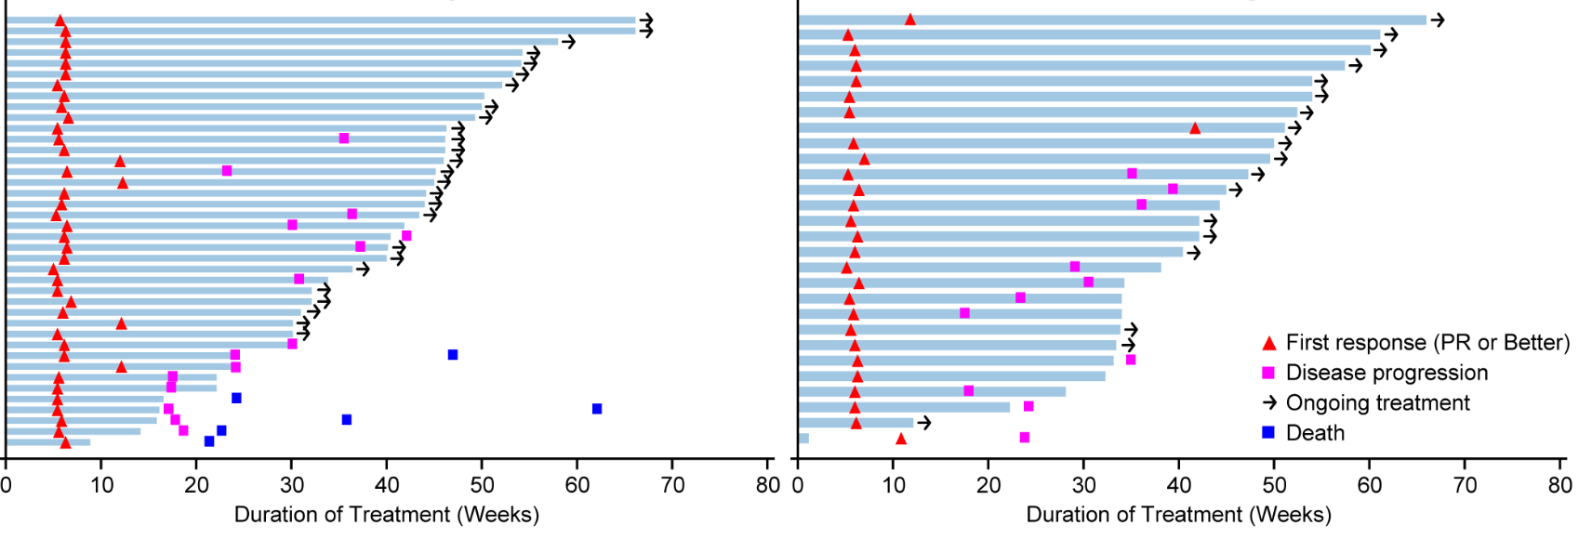
Duration of Response and Treatment
Tarlatamab 10 mg
(n = 40)
Tarlatamab 100 mg
(n = 28)
Patients
Median TTR was 1.4 months (range, 1.1–9.6 months), and median DOR was not reached
Of the 68 responders, the DOR was ≥ 6 months in 40 patients (59%)
56% of the responses were ongoing at data cutoff
Median follow-up time for DOR, 9.5 months (95% CI; 8.3, 9.7 months).
DOR, duration of response; PR, partial response; TTR, time to objective response.
Presented at the European Society for Medical Oncology Congress 2023 Annual Meeting, October 20-24, 2023; Madrid, Spain.

Slide 10
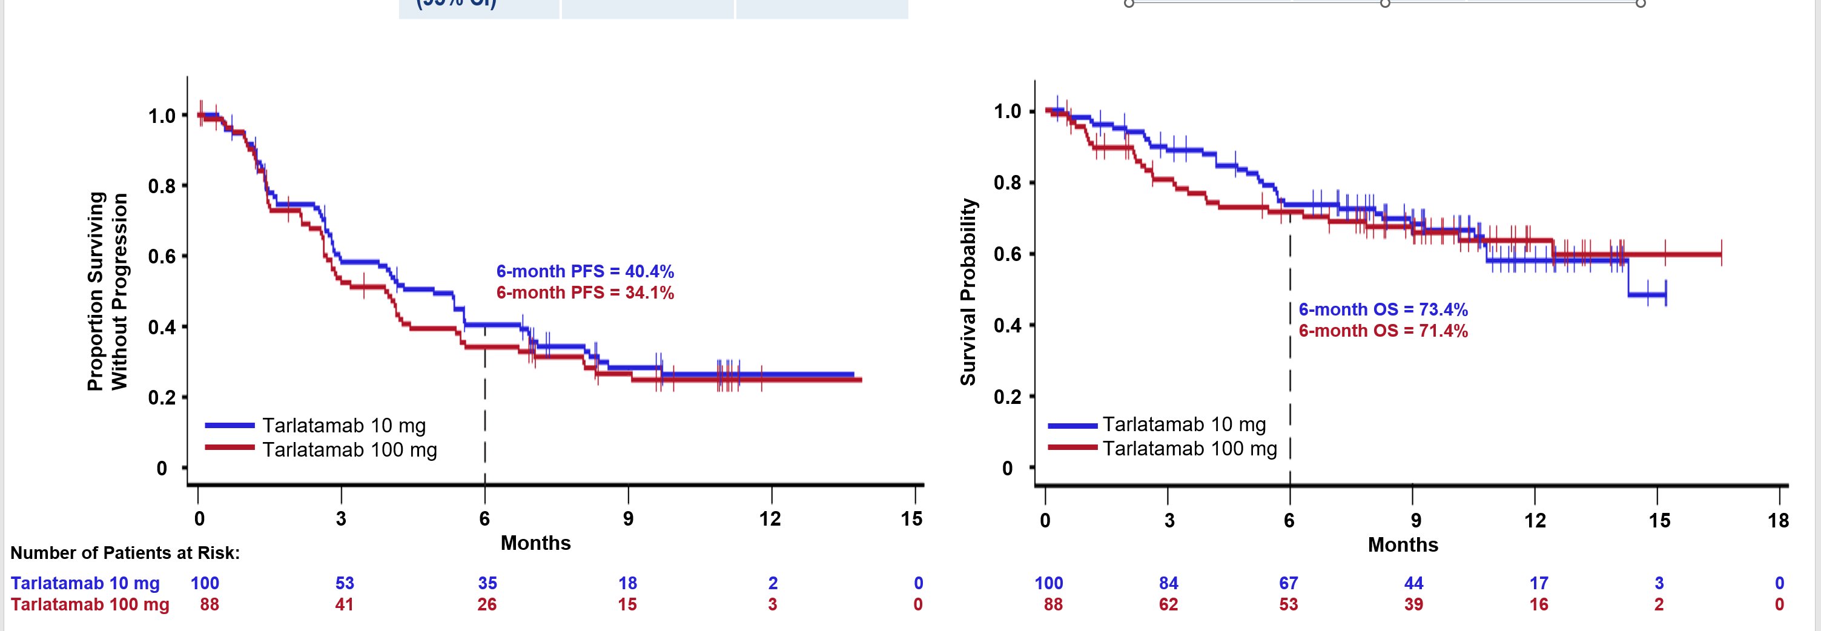
PFS and OS
Outcome | Tarlatamab 10 mg (n = 100) | Tarlatamab 100 mg (n = 88)
Median PFS (95% CI) | 4.9 (2.9, 6.7) | 3.9 (2.6, 4.4)
Outcome | Tarlatamab 10 mg (n = 100) | Tarlatamab 100 mg (n = 88)
Median OS (95% CI) | 14.3 (10.8, NE) | NE (12.4, NE)
OS data is not yet mature; at the last follow-up, 57% of patients in the tarlatamab 10 mg group and 51% of patients in the tarlatamab 100 mg group were still alive
Median follow-up was 10.6 months for tarlatamab 10 mg and 10.3 months for tarlatamab 100 mg.
NE, not estimable; OS, overall survival; PFS, progression-free survival.
Presented at the European Society for Medical Oncology Congress 2023 Annual Meeting, October 20-24, 2023; Madrid, Spain.

Slide 11
Summary of Adverse Events*
TEAEs, n (%) | Part 1 + 2 Tarlatamab 10 mg (n = 99) | Part 1 Tarlatamab 100 mg (n = 87) | Part 3 Tarlatamab 10 mg (n = 34)
Any grade | 96 (97) | 87 (100) | 34 (100)
≥ Grade 3 | 57 (58) | 56 (64) | 22 (65)
Related to tarlatamab, any grade | 89 (90) | 81 (93) | 29 (85)
≥ Grade 3 | 29 (29) | 29 (33) | 5 (15)
Fatal | 0 | 0 | 1 (3)†
Leading to dose interruption/reduction | 14 (14) | 25 (29) | 3 (9)
Leading to discontinuation | 4 (4) | 3 (3) | 0
Most Common TEAEs in ≥ 20% of Patients, n (%) | Part 1 + 2 Tarlatamab 10 mg (n = 99) | Part 1 Tarlatamab 100 mg (n = 87) | Part 3 Tarlatamab 10 mg (n = 34)
CRS | 49 (49) | 53 (61) | 19 (56)
Grade 1–2 | 49 (49) | 48 (55) | 18 (53)
≥ Grade 3 | 0 | 5 (6) | 1 (3)
Decreased appetite | 25 (25) | 38 (44) | 13 (38)
Pyrexia | 38 (38) | 29 (33) | 8 (24)
Constipation | 28 (28) | 22 (25) | 8 (24)
Anemia | 26 (26) | 22 (25) | 9 (26)
Asthenia | 20 (20) | 21 (24) | 10 (29)
Dysgeusia | 24 (24) | 12 (14) | 14 (41)
Fatigue | 21 (21) | 17 (20) | 9 (26)
Tarlatamab demonstrated a favorable safety profile, with a low rate of discontinuations due to treatment-related adverse events (TRAEs)
Shorter inpatient monitoring (Part 3) did not alter the safety profile
*The safety analysis set includes all patients in Part 1, Part 2, and Part 3 who received at least one dose of tarlatamab (N = 220).
†Fatal TRAE was respiratory failure.
CRS, cytokine release syndrome; TEAE, treatment-emergent adverse event.
Presented at the European Society for Medical Oncology Congress 2023 Annual Meeting, October 20-24, 2023; Madrid, Spain.

Slide 12
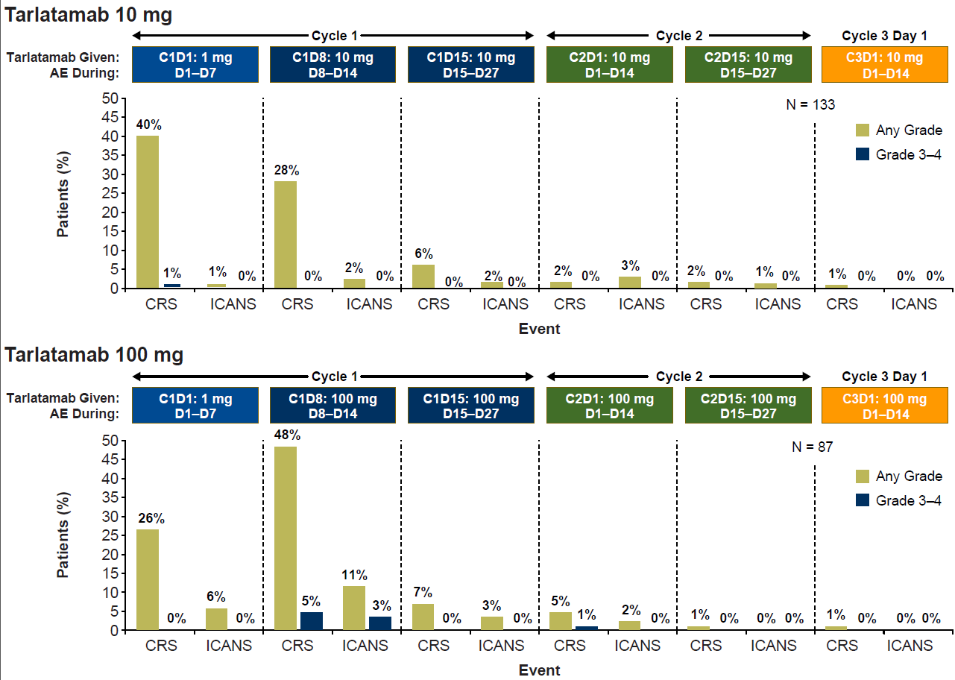
CRS and Immune Effector Cell-Associated Neurotoxicity Syndrome (ICANS)*
CRS was largely confined to the first or second dose, primarily grade 1–2
ICANS* occurred infrequently overall and was predominantly observed with tarlatamab 100 mg
Additional Interventions for CRS:
Patients receiving tarlatamab, n (%) | 10 mg (n = 133) | 100 mg (n = 87)
Tocilizumab | 7 (5) | 9 (10)
Supplemental oxygen | 11 (8) | 8 (9)
Vasopressor support | 1 (1) | 1 (1)
*ICANS includes associated neurologic events based on a broad search using 61 selected preferred terms from MedDRA version 26.0.
AE, adverse event; C, cycle; CRS, cytokine release syndrome; D, day; ICANS, immune effector cell-associated neurotoxicity syndrome.
Presented at the European Society for Medical Oncology Congress 2023 Annual Meeting, October 20-24, 2023; Madrid, Spain.

Slide 13
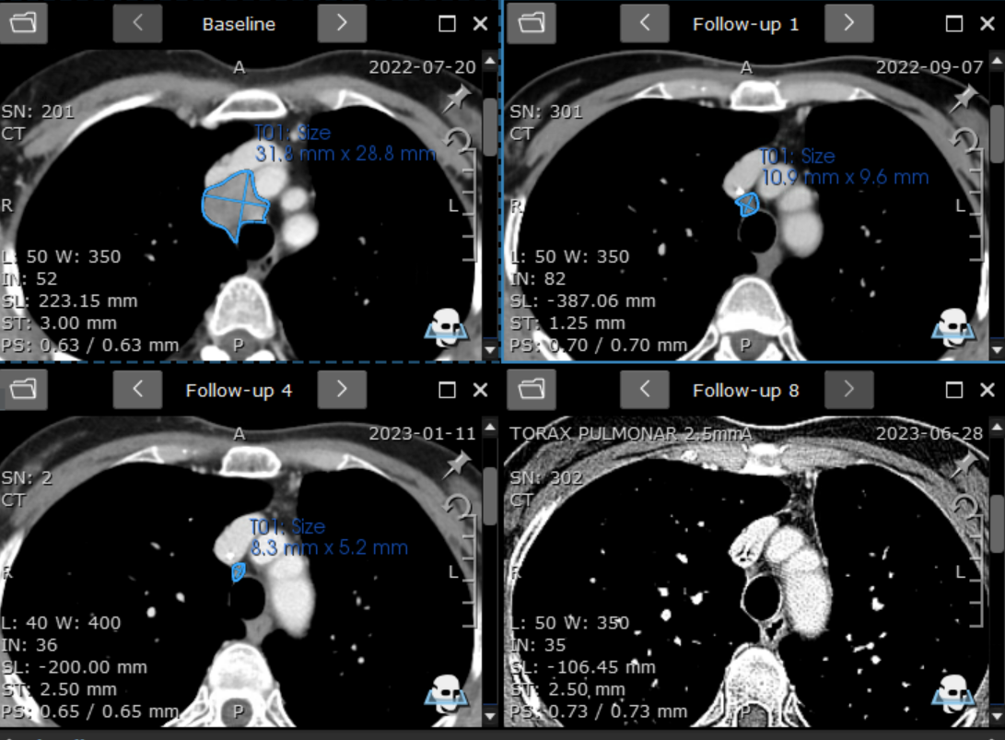
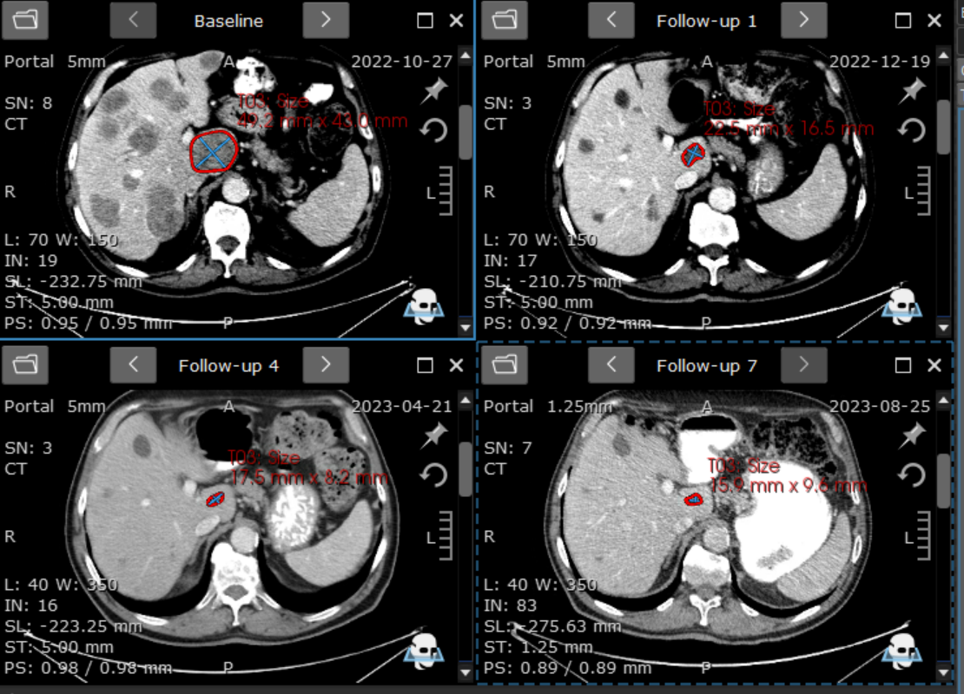
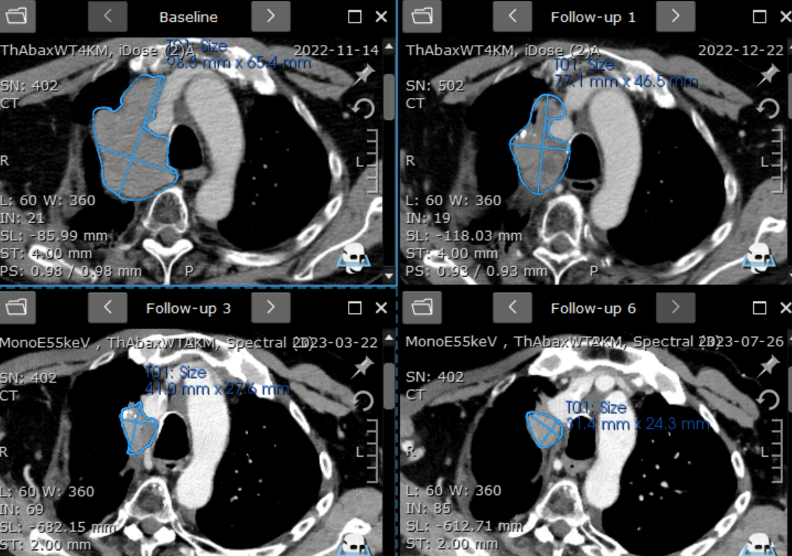
Patient Case (Tarlatamab 10 mg)
Case 1
Case 2
Baseline | Week 6 | Week 48
Baseline | Week 6 | Week 42
3.2 x 2.9 cm
1.1 x 1.0 cm
absent
67-year-old male with 2 prior lines of therapy
Best overall response: partial response, ongoing
Demographics/baseline characteristics
51-year-old female with ES-SCLC and progression after 3 prior lines of therapy
Metastatic disease in lung (prior RT), brain (prior WBRT), and lymph nodes
Response to tarlatamab
Best overall response: partial response
Time to response: 1.5 months
Duration of response: 12.5 months and ongoing
Key adverse events after Cycle 1 Day 1 tarlatamab (1 mg) dose
Grade 1 CRS started 20 hours after end of infusion
              Progressed to grade 2 CRS 4 hours later (hypotension)
  Grade 3 pancreatitis, grade 2 rash
  Treatment: IV fluids, dexamethasone 4 mg, analgesics
  Discharged after 9 days, and received tarlatamab 10 mg on Cycle 1 Day 15
Case 3
Baseline | Week 6 | Week 42
58-year-old male with 3 prior lines of therapy
Best overall response: partial response, ongoing
CRS, cytokine release syndrome; ES-SCLC, extensive stage-small cell lung cancer; IV, intravenous; RT, radiation therapy; WBRT, whole brain radiation therapy.
Presented at the European Society for Medical Oncology Congress 2023 Annual Meeting, October 20-24, 2023; Madrid, Spain.

Slide 14
DeLLphi-301 Conclusions
Tarlatamab 10 mg demonstrated durable anticancer activity and manageable safety
  ORR was 40%, observed DOR was ≥ 6 months in 58% of responders, 6-month PFS was 40%, and 6-month OS was 73%
  The most common TEAE was CRS, which primarily occurred in cycle 1, was mostly grade 1–2, and was generally manageable with supportive care
  Discontinuation of tarlatamab due to TRAEs was low (3%)
  Shorter inpatient monitoring (Part 3) did not alter the safety profile
  Tarlatamab 10 mg was the selected dose for further development
The ongoing phase 3 DeLLphi-304 study will compare the efficacy and safety of tarlatamab (10 mg Q2W) with standard-of-care chemotherapy⁶
Results support the use of tarlatamab in patients with previously-treated SCLC
CRS, cytokine release syndrome; DOR, duration of response; ORR, objective response rate; OS, overall survival; PFS, progression-free survival;
Q2W, every 2 weeks; SCLC, small cell lung cancer; TEAE, treatment-emergent adverse event; TRAE, treatment-related adverse event.
Presented at the European Society for Medical Oncology Congress 2023 Annual Meeting, October 20-24, 2023; Madrid, Spain.

Slide 15
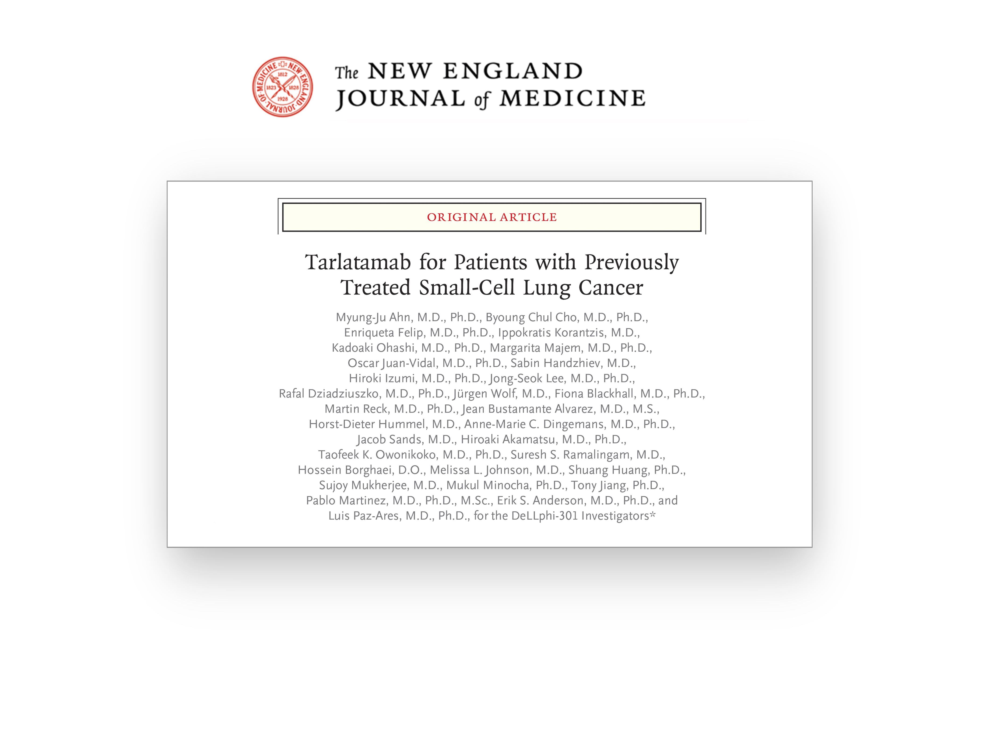
The DeLLphi-301 Manuscript is now Published
Presented at the European Society for Medical Oncology Congress 2023 Annual Meeting, October 20-24, 2023; Madrid, Spain.

Slide 16
Acknowledgements
The authors thank all patients and their families for their participation in this study, and all investigators
Medical Writing Support
Medical writing support for this presentation was funded by Amgen Inc. and was provided by Lisa Denny, PhD, of ICON plc (Blue Bell, PA)
Funding
This study was funded by Amgen Inc.
Contact Information
Presenting author, Luis Paz-Ares (lpazaresr@seom.org)
Presented at the European Society for Medical Oncology Congress 2023 Annual Meeting, October 20-24, 2023; Madrid, Spain.

Slide 17
DeLLphi-301 Investigators
Presented at the European Society for Medical Oncology Congress 2023 Annual Meeting, October 20-24, 2023; Madrid, Spain.

Slide 18
References
Sabari JK, et al. Nat Rev Clin Oncol. 2017; 14:549–561.
Mathieu L, et al. Oncologist. 2021; 26:433–438.
Lemery S, Pazdur R. Nat Rev Clin Oncol. 2022; 19:217–218.
Giffin MJ, et al. Clin Cancer Res. 2021; 27:1526–1537.
Paz-Ares L, et al. J Clin Oncol. 2023; 41:2893–2903.
Clinicaltrials.gov. NCT05740566. Accessed from https://clinicaltrials.gov/study/NCT05740566.
Presented at the European Society for Medical Oncology Congress 2023 Annual Meeting, October 20-24, 2023; Madrid, Spain.

